Slide 1

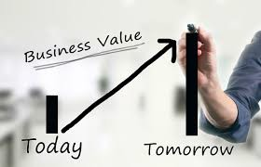
MIS782
Value of Information
Class Week 10

Slide 2
MIS782: Value of information
HOW DO ICT INVESTMENTS GENERATE VALUE?
Firms need to understand: | How to gain competitive advantage based on the their underlying resources. | How competitive advantage from business and how emerging IT opportunities, such as social media analytics, can generate business value from investments in these areas. | Analyse how organisations adapt to changes or disruptors in the technology landscape to preserve and sustain an advantage.
In this unit, we will discuss: | Course One + Two | Course Three + Four | Course Five
 | Business Value Returns from IT Investments IT Portfolio Theory 3. Analysing competitive advantage - RBV 4. Analysing competitive advantage - VRIO | Analytics as a capability - I Business Case Development Analytics as a capability - II: From business data to business insight Emerging sources and SMA | 9. Dynamic capabilities through Information Asymmetries 10. Competing on Information Asymmetries

Slide 3
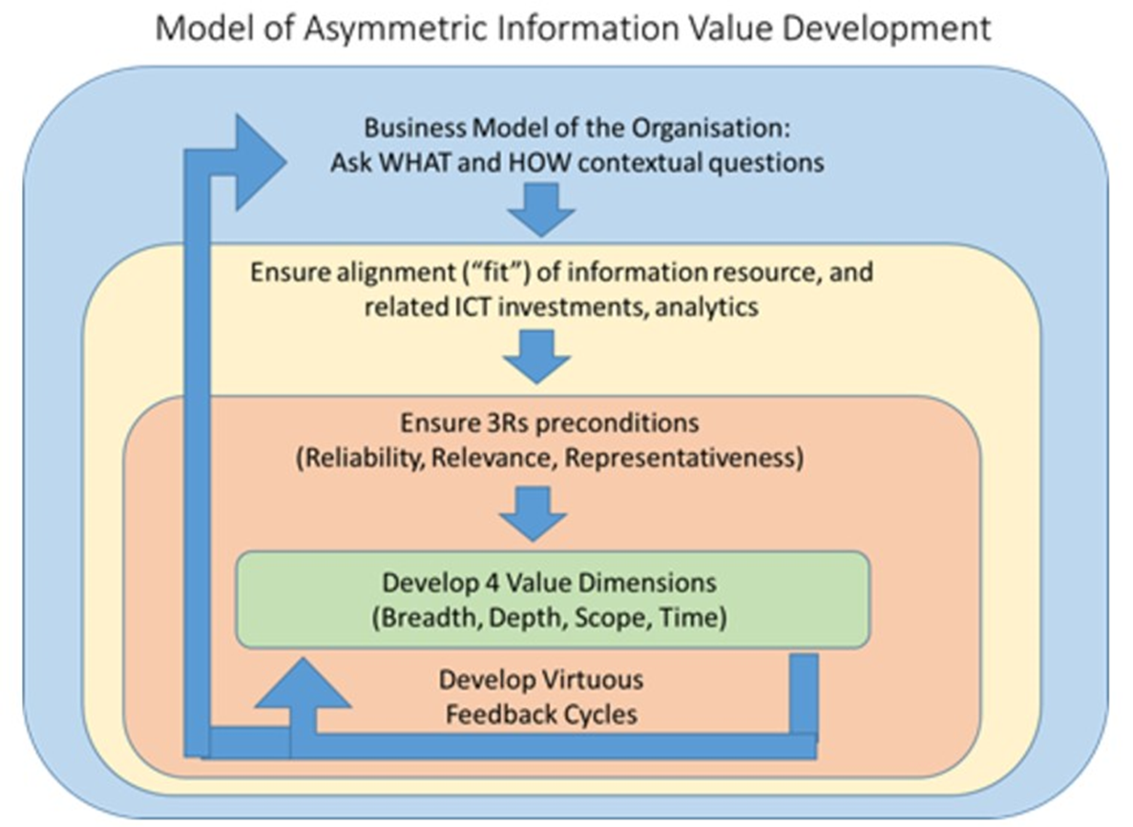
Building Analytical Capability
Developed and presented by Scheepers, R, Straub D, W in 2016

Slide 4
Recap: Building Analytical Capability
q Understand the context
´ 3 Key Contextual Questions: What, Why & How?
q Constraints of information capture (information architecture)
´3 Antecedent Conditions (3R’s)
q Build information repository to extract value
´4 Value Dimensions
q Today: Build in Flexibility
´1 or more Virtuous Feedback Cycles (Dynamic Capabilities)

Slide 5
Understand the context
3 Key Contextual Questions: What, Why & How?
WHAT and Why questions:
What are we trying to achieve in this business?
What are our key competitive advantages?
What kinds of decision-making does this imply?
Therefore, what kinds of information should we have at our disposal?
HOW questions:
How should we set up the relevant analytics capabilities and associated information resources to enable our stakeholders to make evidence-based and optimal decisions?
How could we augment the value of the underlying information resources, both now and into the future as our business model evolves?

Slide 6
Recap: Information as a Competitive Resource
´ Reliability, relevance and representativeness of information
´ Four dimensions of information value:
´ Depth - Having access to more detailed information than your competitors
´ Breadth - Having access to greater volumes of information than competitors
´ Scope - Information that provides a more holistic perspective
´ Time - Having access to information sooner or more often

Slide 7
Structure of an Analytics capability
Analytical Capabilities
Knowledge & Skills
Big Data
Potential
Stakeholder
Value Creation
Technical Systems & Processes
Internal Capabilities, e.g.:
Data Sourcing
Transformation
Combination
Value Dimensions
Volume
Scope
Granularity
Time
Decision Spectrum
Range
Depth
Stakeholders
Stakeholders
´ ´ Making sure you can perform analytics
´ From raw data to decisions
´ Variety of decisions you can make and impact that decisions will have
Stakeholders
Managerial Systems & Processes
Values & Norms
The Principal framework (presented by Scheepers, R. at the IBM Centre for Excellence in 2016).

Slide 8
How can organisations develop the value of their information and maintain this over time?
Answer: by developing “virtuous cycles”
What is a virtuous cycle?
A routine process, enabling feedback and adaptation of information to ensure:
the 3 R’s of reliability, relevance, and representativeness over time
Information Value develops on each of the 4 value dimensions
Each of the four value dimensions imply aspects which an organisation might choose to develop through "virtuous cycles" (Applegate et al. 2009)

Slide 9
Information Asymmetry
A’s Value of Information
Organisation A
B’s Value of Information
Organisation B

Slide 10

Virtuous Feedback Cycles
´ Highly competitive markets demand rapid business evolution
´ Dynamic capabilities can provide:
Timely responses to change (sensing),
Rapid and flexible product innovation (seizing), coupled with,
The capability to redeploy core capabilities (reconfiguring / transforming).
´ Prerequisites:
´ IT investments should align with the business model
´ IT investments should align with the evolution of the business model

Slide 11

Information Value & Virtuous Cycles
Value of
Information
Organisation
Individuals

Slide 12

Information Value & Virtuous Cycles
Value of
Information
Online users

Slide 13


Information Value & Virtuous Cycles
Value of
Information
Consumers

Slide 14
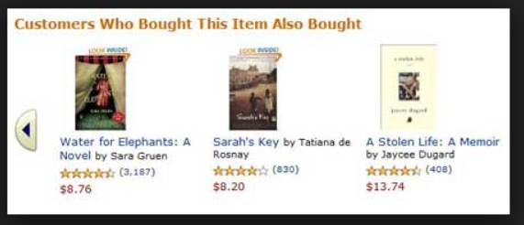

Information Value & Virtuous Cycles
Value of
Information
Readers

Slide 15


Information Value & Virtuous Cycles
Value of
Information
Readers

Slide 16
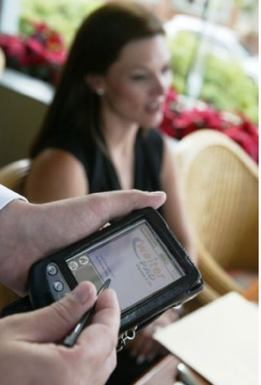
Information Value & Virtuous Cycles
Value of
Information
Bistro Restaurant
Patrons

Slide 17
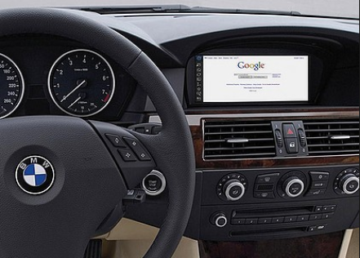

Information Value & Virtuous Cycles
Value of
Information
Drivers

Slide 18
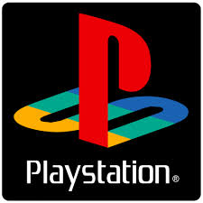

Information Value & Virtuous Cycles
Value of
Information
Games enthusiasts

Slide 19
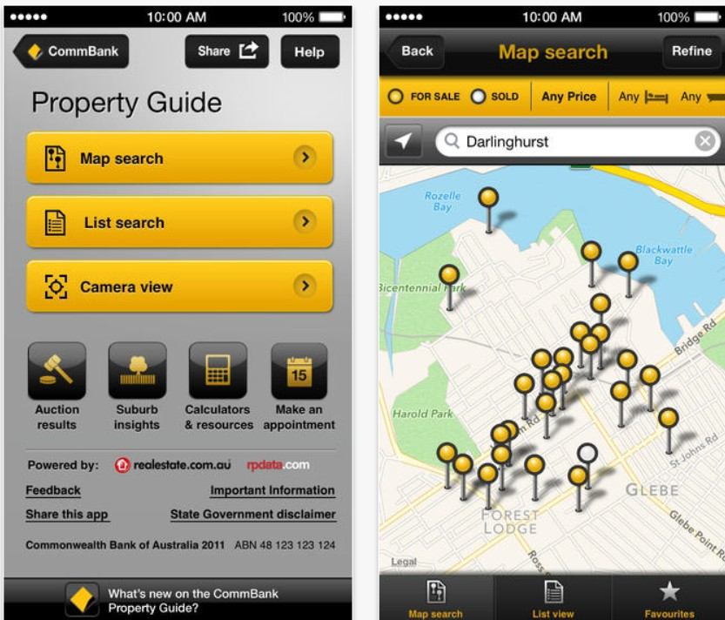
Developing Information Asymmetries
´ VRIO
´ Having V, R or I information
´ Having the O to use the information
´ Making smarter decisions than competitors
´ It is not necessary to own the information
´ Alliances possible
´ Commonwealth Bank has partnered with Realestate.com.au to develop a location-aware application (see right)
´ App enables prospective homebuyers to access information from realestate.com.au about the property, and to obtain financial details and financing options on the spot
Notes:
Commonwealth Bank has partnered with a Realestate.com.au and have developed a location-aware mobile phone application to enable prospective homebuyers, standing outside a property of interest, to obtain details about the property, typical prices in the area, etc., and then to apply for preapproval for finance on the spot.
This is an example of how the concept of a information resource can be extended to the inter-firm context (refer Das and Teng 2000; Eisenhardt and Schoonhoven 2000), notably in terms of having access to, rather than direct control of, resources.

Slide 20
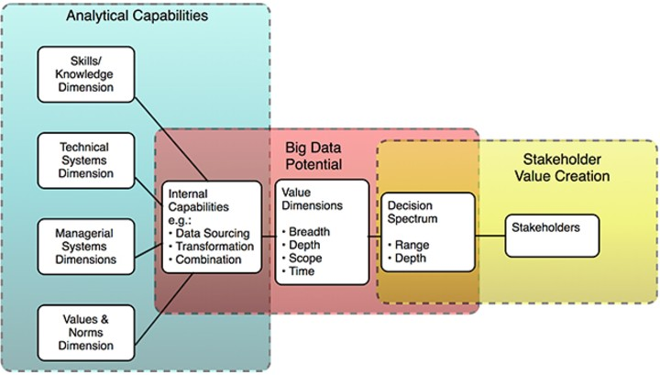
Bringing It All Together – Virtuous Feedback Cycles

Slide 21

Amazon and Virtuous Feedback Cycles
´ Why does Amazon dominate the market?
´ Information unobtainable to competitors
´ Organisational capabilities to gain and utilise this information
´ Virtuous feedback cycles
´ Identify the purpose(s) and information value(s) in Amazon’s activities listed below:
´ Recording data on customer behaviour (e.g. past purchases, reviews, click- through data)
´ Embedding a recommendation engine to encourage purchases
´ Recording customer searches that don’t return results

Slide 22
Asymmetric Information Development Requirements
Reflecting on the organisation’s business model
´ Asking the key contextual questions (what, why and how)
Ensuring alignment between business model, information resources, and IT investments
Ensuring that information sources are reliable, relevant and representative
Develop value along each of the 4 information value dimensions
´ Breadth, depth, scope, and time
Designing virtuous feedback cycles and related dynamic capabilities
´ Sensing and seizing opportunities, and transforming them into value

Slide 23
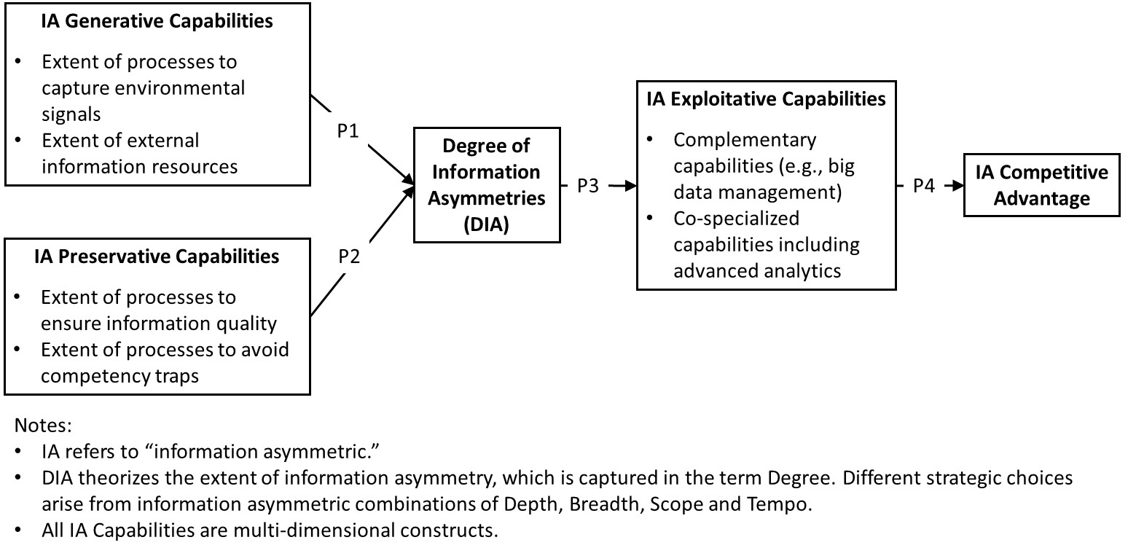
Current state of Theory of Information Asymmetry (TIA)

Slide 24
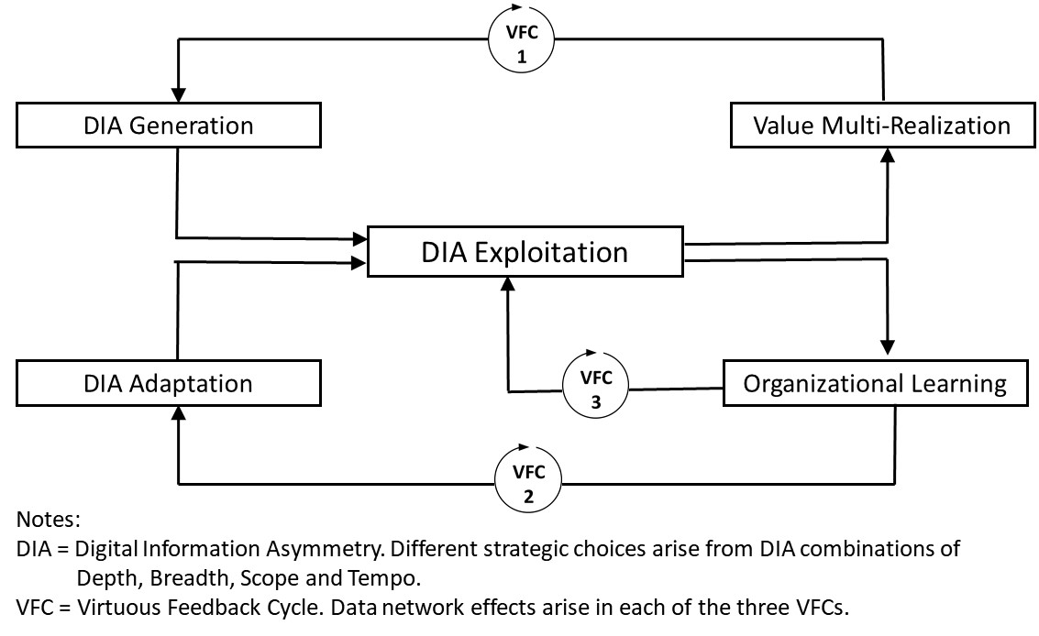
Further iteration
Notes:
We define Digital Information Asymmetries as manifestations of information asymmetries in digital form, specifically geared for machine-based (automated), human-assistive and hybrid application:
DIAs are compared to those of rivals in terms of strategic choices of Breadth, Depth, Scope, and Tempo and combinations of the same.
DIAs are generated by leveraging external digital information, unique strategic partner information, and internal information resources into asymmetries (of any type or combination of the same). Data network effects (Clough and Wu 2020, Hagiu and Wright 2020, Gregory et al. 2021a) are leveraged in DIA generation.
DIAs must be adapted to ensure information quality in an ongoing basis, and the relevance of digital information periodically. Data network effects are leveraged in DIA adaptation.
DIAs are exploited through the use of AI, analytics in combination with complementary and co-specialised capabilities, resulting in value multi-realisation (see below) and organisational learning. Data network effects are leveraged in DIA exploitation (Alaimo et al. 2020, Hagiu and Wright 2020, Gregory et al. 2021a).
(Preamble to section). Nomological nets explained (Cronbach and Meehl 1955), defines constructs and interactions. We identify three different “virtuous feedback cycles” (VFCs) (Applegate et al. 2006) in these interactions. Data network effects arise in each of these cycles. DIA Nomological net presented and explained in subsequent sections.

Slide 25
Looking ahead - Exam Exam Exam !!!
Next class week
Dynamic Capabilities with Dr. David Teece – YouTube
https://go.blueja.io/6mR0NZvy0kqPXG4W-v0osg

Slide 26

QR code for eVALUate Scan the QR Code to go directly to give feedback on your unit (on-campus)
(cut and paste your unique QR code from your email here)

Slide 27

QR code for eVALUate Scan the QR Code to go directly to give feedback on your unit (off-campus/Cloud)
(cut and paste your unique QR code from your email here)

